Slide 1
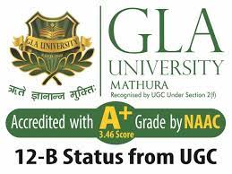
BCA Ist Semester
PROBLEM SOLVING USING COMPUTER
Course Code: BCAC 0018
Presented by:
Mr.Shivank Chauhan
Dept. Of CEA
GLA University, Mathura

Slide 2
Why this chapter??
Computers are an integral part of our lives.
Wherever we are—sitting in our homes, working in the office, driving on roads, sitting in a movie hall, staying in a hotel, etc.—our lives are directly or indirectly affected by the computers.
In this era of information, we are dependent on the storage, flow and processing of data and information, which can only be possible with the help of computers.
The purpose of this chapter is to introduce you to the “computer”.

Slide 3
Cont’d
They are used for the reservation of tickets for airplanes and railways
payment of telephone and electricity bills, deposit and withdrawal of money from banks
processing of business data, forecasting of weather conditions, diagnosis of diseases, searching for information on the Internet, etc.
Computers are also used extensively in schools, universities, organizations, music industry, movie industry, scientific research, law firms, fashion industry, etc.

Slide 4
What is Computer?
The term computer is derived from the word compute.
The word compute means to calculate.
A computer is an electronic machine that accepts data from the user, processes the data by performing calculations and operations on it, and generates the desired output results.
Computer performs both simple and complex operations, with speed and accuracy.

Slide 5
Parts of computer system
Computer is an electronic device that accepts data as input, processes the input data by performing mathematical and logical operations on it, and gives the desired output.
The computer system consists of four parts
(1) Hardware, (2) Software, (3) Data, and (4) Users.
The parts of computer system are shown in Figure 1.1

Slide 6
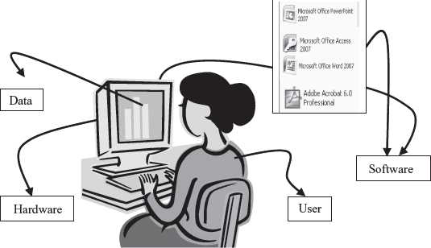
THE COMPUTER SYSTEM
Fig-1.1

Slide 7
Hardware
Hardware consists of the mechanical parts that make up the computer as a machine.
The hardware consists of physical devices of the computer.
The devices are required for input, output, storage and processing of the data.
Keyboard, monitor, hard disk drive, floppy disk drive, printer, processor and motherboard are some of the hardware devices

Slide 8
Software
Software is a set of programs that tells the computer about the tasks to be performed and how these tasks are to be performed.
Program is a set of instructions, written in a language understood by the computer, to perform a specific task. A set of programs and documents are collectively called software.
The hardware needs to be instructed about the task to be performed. Software instructs the computer about the task to be performed. The hardware carries out these tasks.
Different software can be loaded on the same hardware to perform different kinds of tasks.

Slide 9
Data
Data are isolated values or raw facts, which by themselves have no much significance.
the quantities, characters, or symbols on which operations are performed by a computer, which may be stored and transmitted in the form of electrical signals and recorded on magnetic, optical, or mechanical recording media.

Slide 10
Users
Users are people who write computer programs or interact with the computer.
They are also known as Programmers, data entry operators, system analyst and computer hardware engineers fall into this category.

Slide 11

The Input-Process-Output Concept
A computer is an electronic device that→
(1) accepts data, (2) processes data, (3) generates output,
and (4) stores data.
Referred to as input-process-output concept.

Slide 12
Input
The computer accepts input data from the user via an input device like keyboard.
The input data can be characters, word, text, sound, images, document, etc.

Slide 13
Process
The computer processes the input data. For this, it performs some actions on the data by using the instructions or program given by the user of the data.
The action could be an arithmetic or logic calculation, editing, modifying a document, etc.
During processing, the data, instructions and the output are stored temporarily in the computer’s main memory.

Slide 14
Output
The output is the result generated after the processing of data. The output may be in the form of text, sound, image, document, etc.
The computer may display the output on a monitor, send output to the printer for printing, play the output, etc.

Slide 15
Storage
The input data, instructions and output are stored permanently in the secondary storage devices like disk or tape.
The stored data can be retrieved later, whenever needed

Slide 16
END

